Slide 1
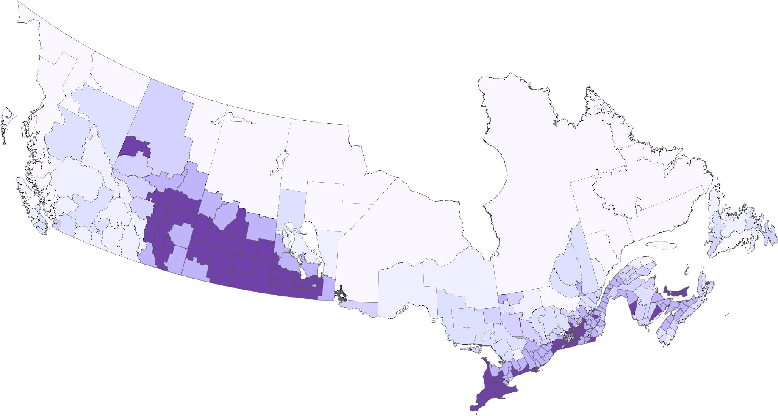
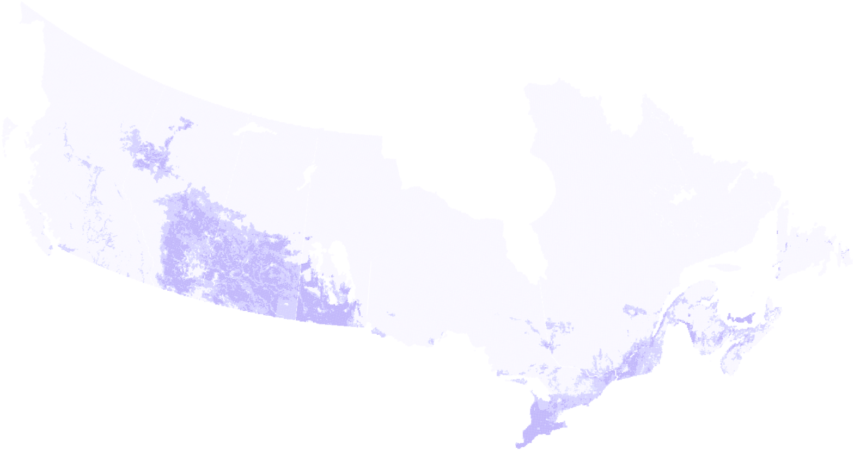
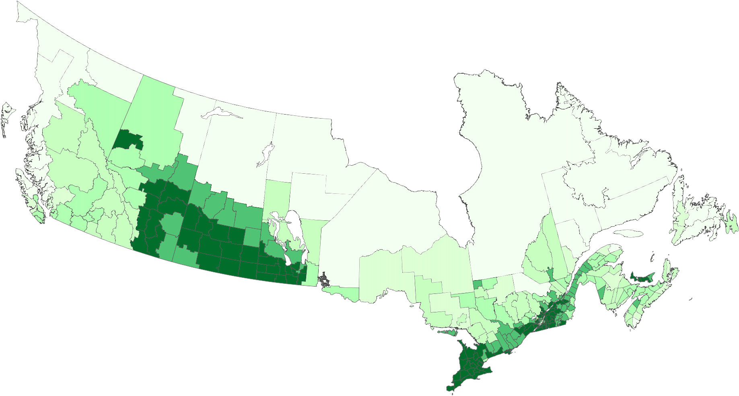
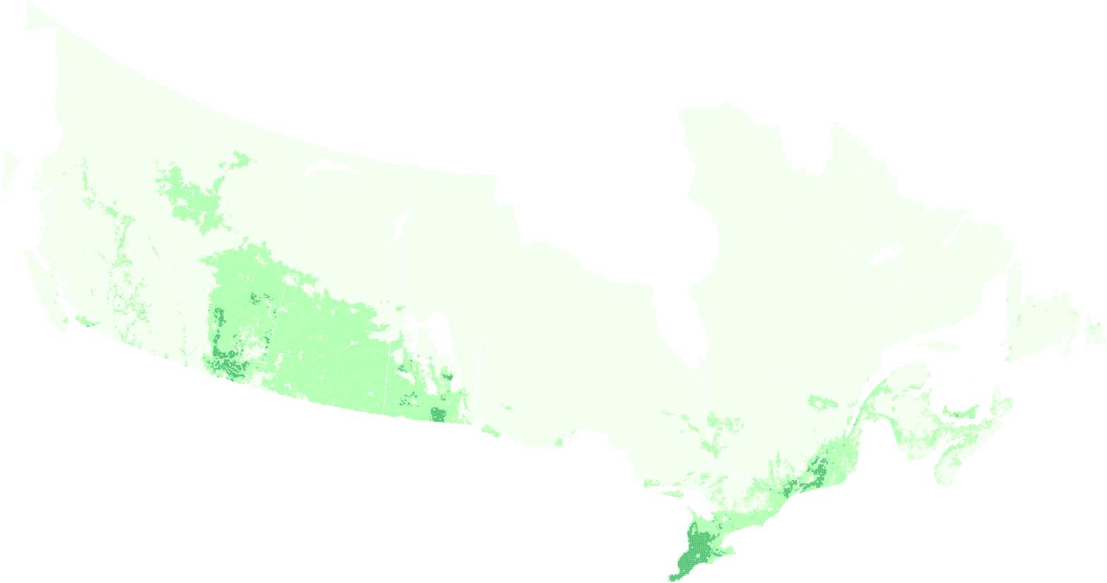
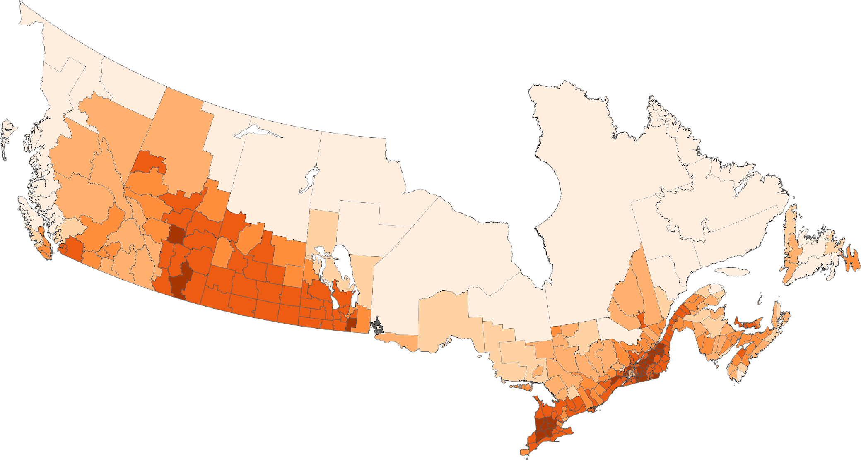
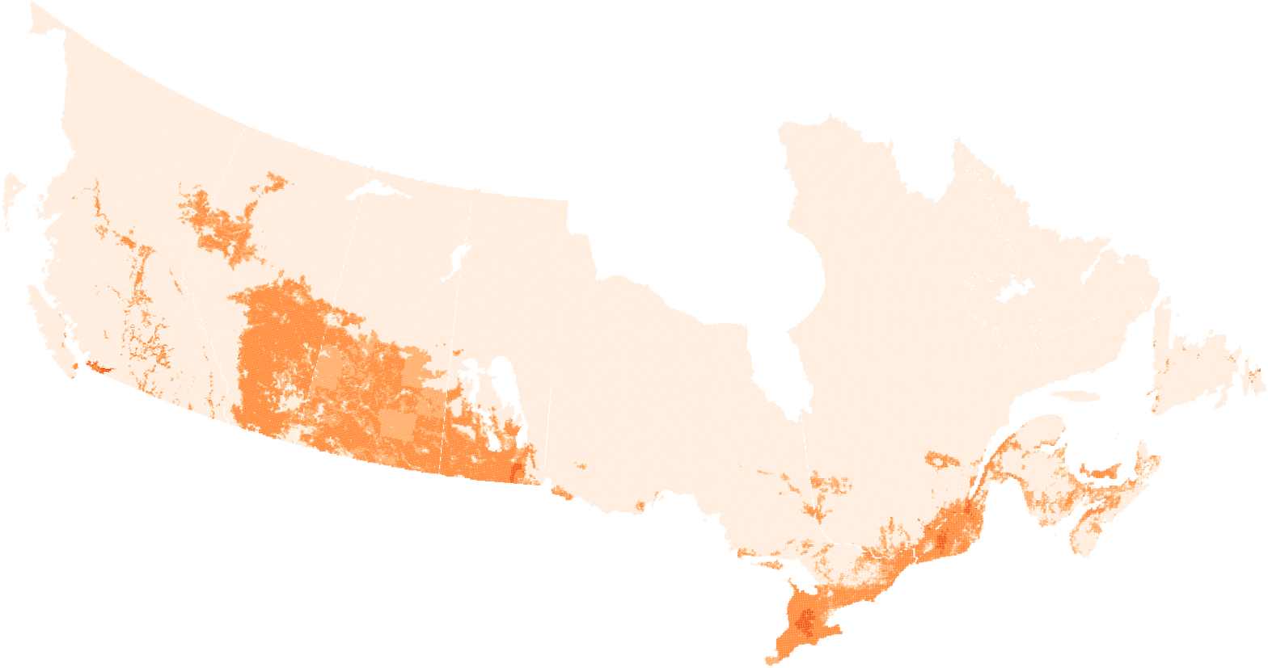
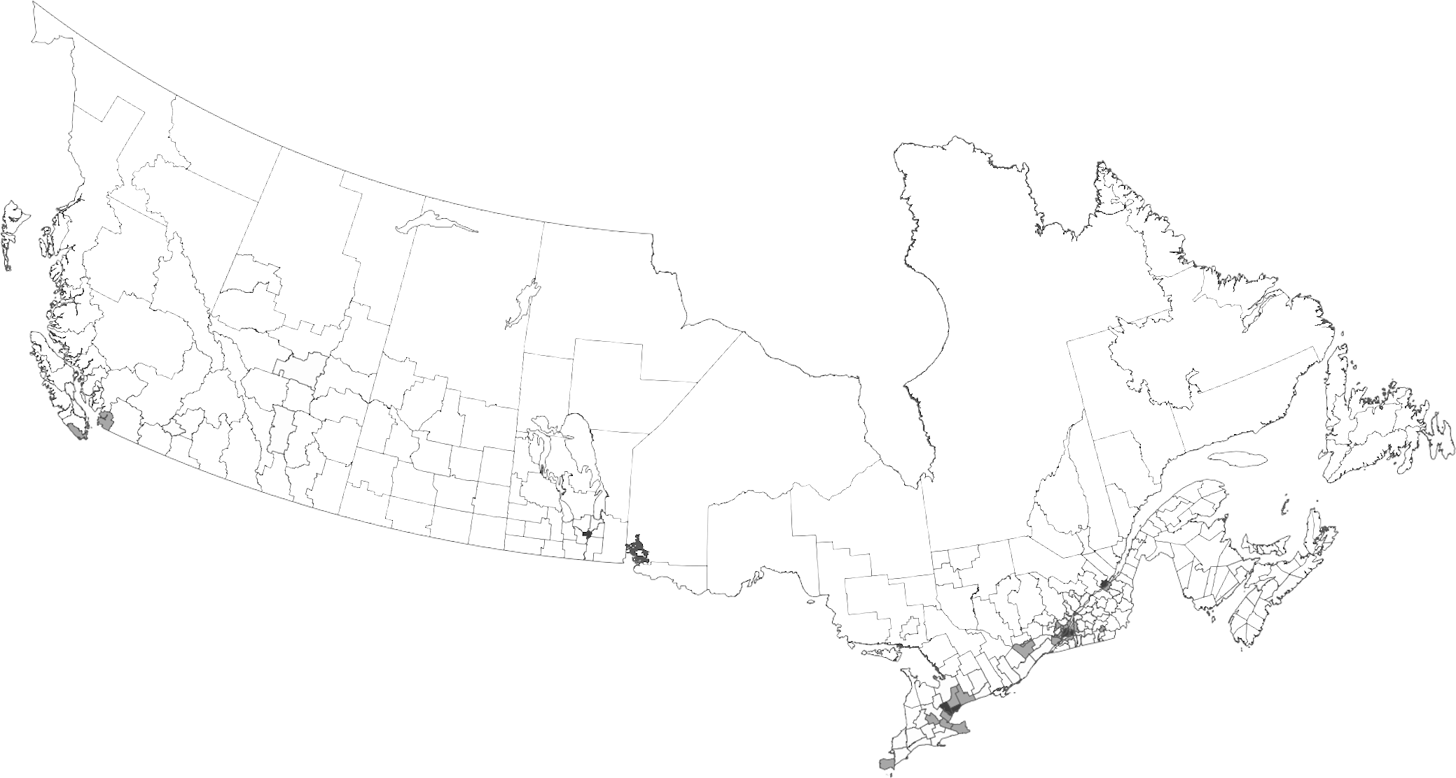

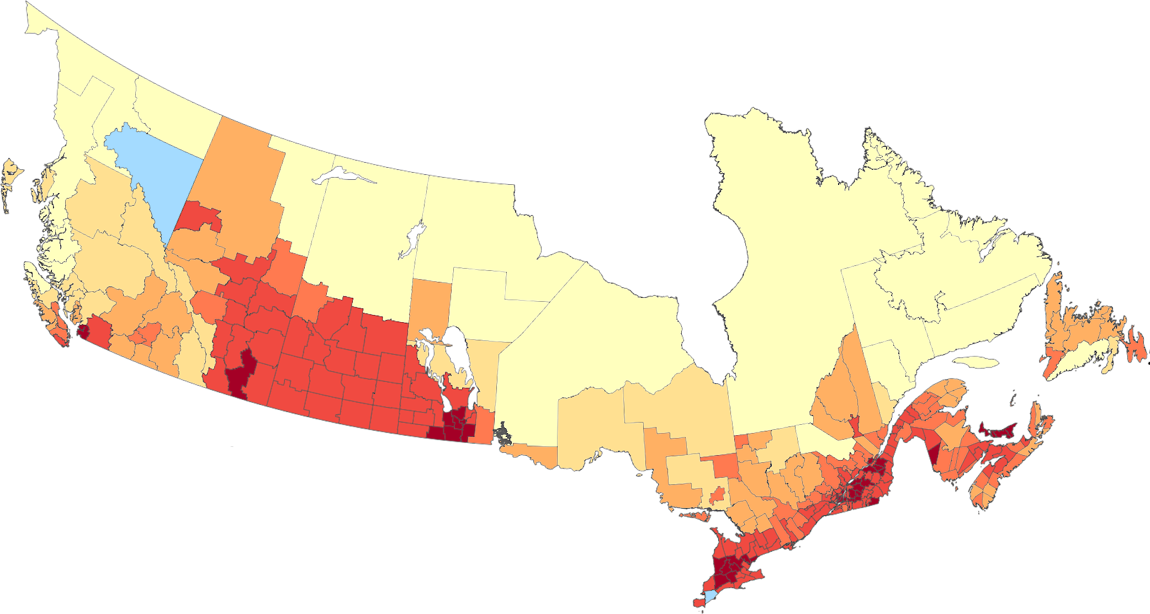
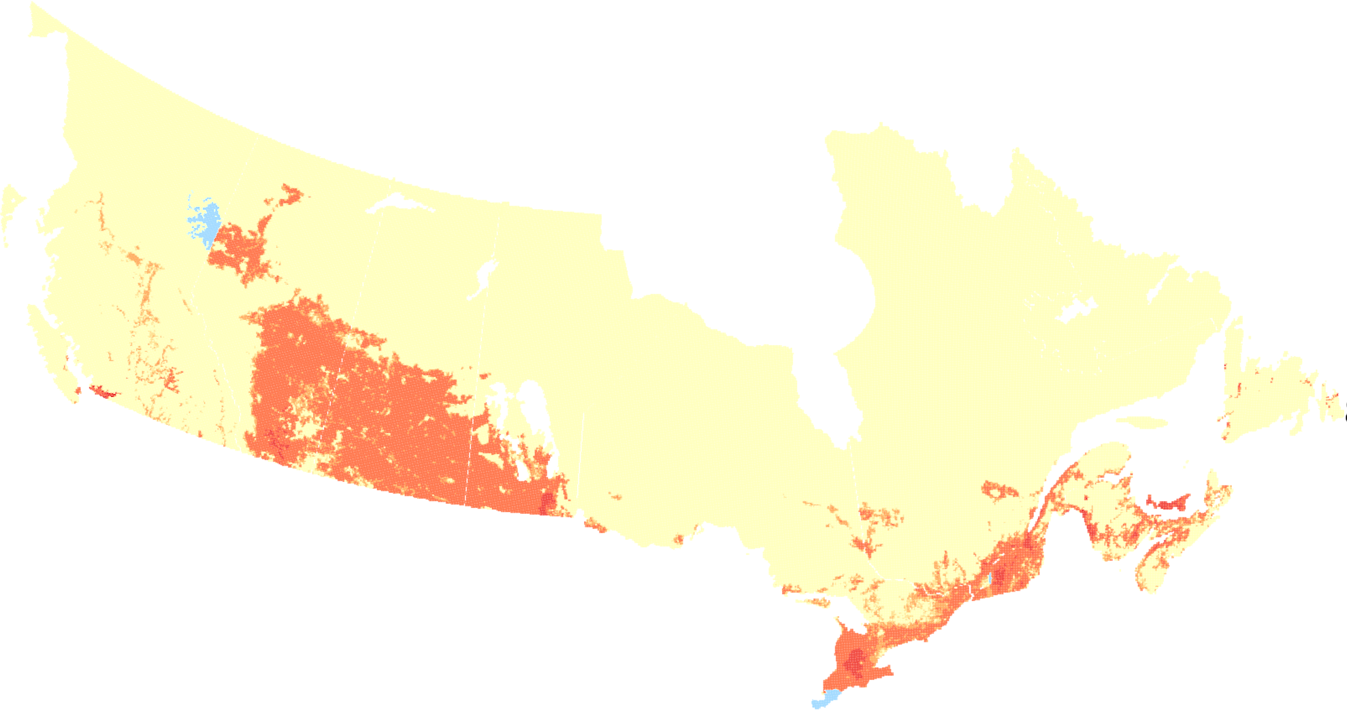
Section: Data Preprocessing
Section: Deriving County-scale Nutrient Components
Section: Creation of gridded dataset
Section: Creation of gridded dataset
Raw data
County-scalexxxxxxxxx
Raw data
Gridded
Fertilizer sales
Fertilizer P
Fertilizer P
Annual Crop Inventory (ACI) - agricultural land -
Harvested crop area
Crop and Pasture P Removal
Crop and Pasture P Removal
Crop yield
Livestock Manure P
Livestock Manure P
Pasture area
ACI - urban land -
Domestic Waste P
Domestic Waste P
Livestock inventory
Population
P Surplus
P Surplus

